Slide 1
Data Science Capstone Project
Local Governments Survey (ARISE + CivicPulse Harmonization)
Course Number:CS896 Team #7- Anudeepthi Chirumamilla- Y828R524 Rupali Avhad - d798z925 Teja Sree Mukkapati-Q389W584

Slide 2
This Week Progress Update
This Week Progress Update
This week, we moved from basic harmonization into deeper analysis of the combined dataset. We added correlation analysis, cross-tabulations, percentage-based comparisons, visualizations, and regression models. These steps helped us better understand the relationship between workforce challenges, fiscal condition, and infrastructure stress across ARISE and CivicPulse data.

Slide 3
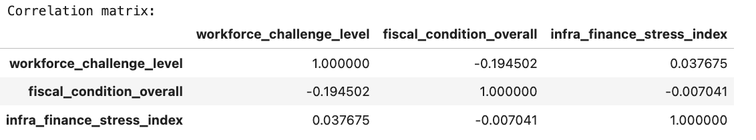
Correlation Matrix
Correlation Matrix of Key Variables
We created a correlation matrix using three main harmonized variables:
Workforce challenge level
Fiscal condition overall
Infrastructure finance stress index
This helped us measure how strongly these variables are related. The results showed that some relationships are weak, while others are more meaningful. Correlation analysis gave us a quick overall view before moving into more detailed comparisons and regression analysis.

Slide 4
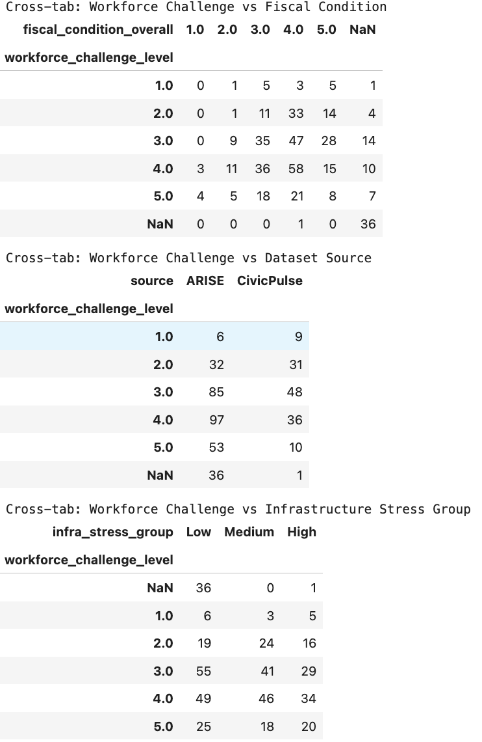
Cross-Tabulations
Cross-Tabulations for Category Comparison
We created cross-tabulations to compare workforce challenge levels with:
Fiscal condition
Dataset source
Infrastructure stress group
These tables helped us see how response levels are distributed across categories. Instead of only looking at averages, cross-tabs showed the actual count patterns in the data, which makes comparisons more meaningful and easier to interpret.

Slide 5
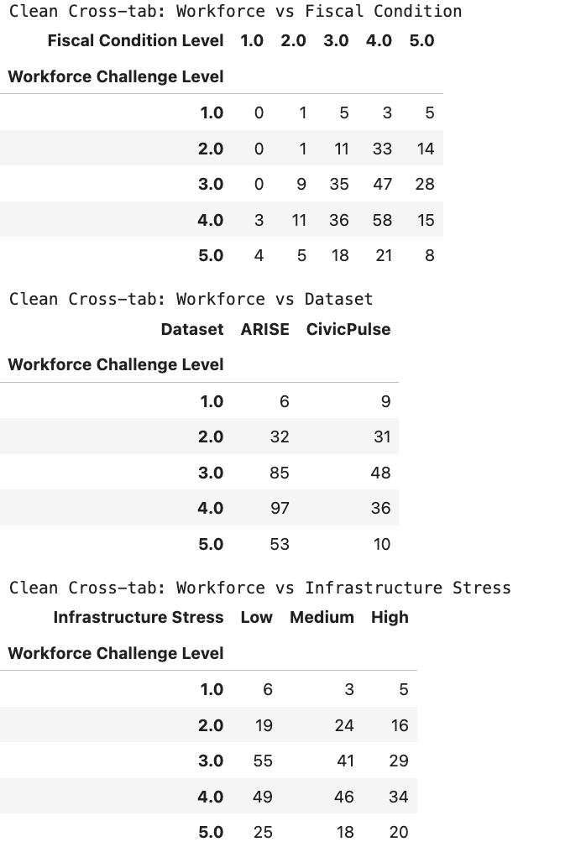
Cleaned Cross-Tabs
Cleaned Cross-Tabs for Better Clarity
After generating the original cross-tabs, we cleaned them by removing NaN values for better readability. This made the tables clearer and easier to present. The cleaned cross-tabs gave a more structured view of:
Workforce challenge vs fiscal condition
Workforce challenge vs dataset
Workforce challenge vs infrastructure stress
This step improved the quality of interpretation and presentation.

Slide 6
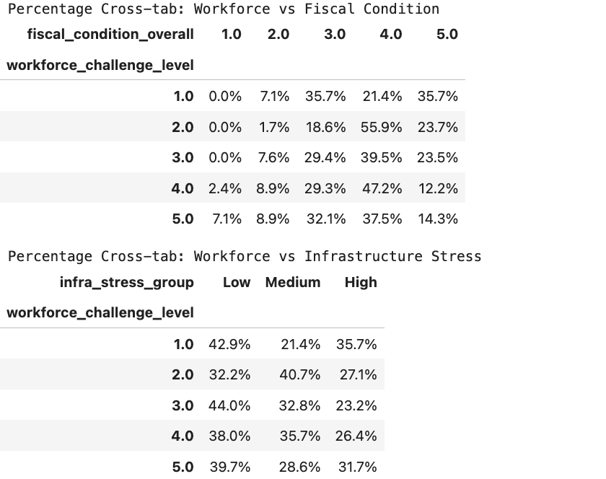
Percentage Cross-Tabs
Percentage-Based Cross-Tab Analysis
We also converted selected cross-tabulations into row percentages. This helped us understand proportions instead of only counts. Percentage cross-tabs were useful because they showed how responses are distributed within each workforce challenge level. This makes the comparison more balanced, especially when groups have different sizes.

Slide 7
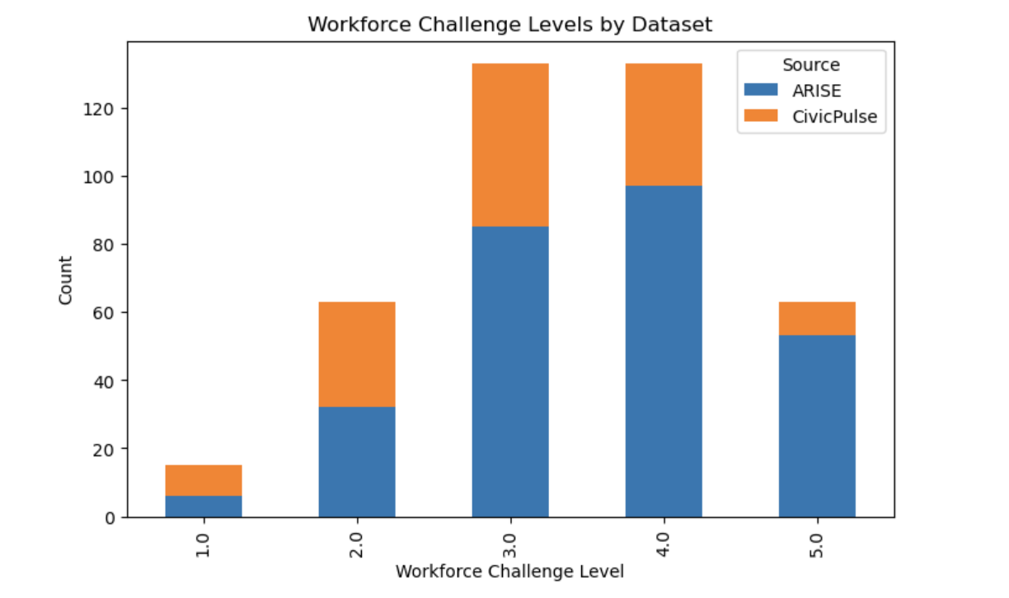
Stacked Bar Chart: Workforce by Source
Workforce Challenge Levels by Dataset Source
We created a stacked bar chart to compare workforce challenge levels across ARISE and CivicPulse. This visualization helps show how the two datasets differ in response distribution. It gives a quick visual comparison of whether one dataset reports more high or low workforce challenge levels than the other.

Slide 8
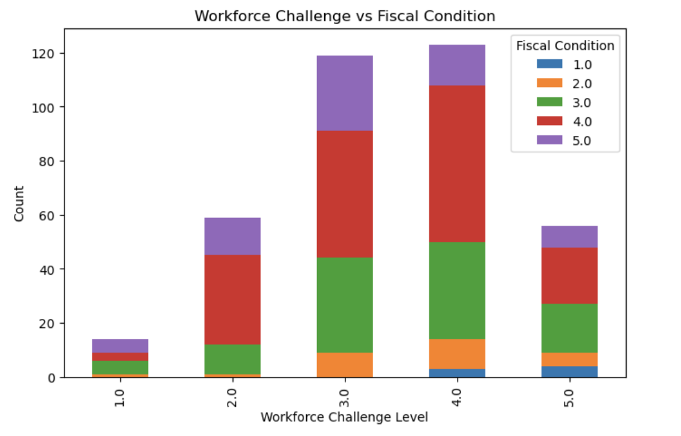
Stacked Bar Chart: Workforce vs Fiscal Condition
Workforce Challenge vs Fiscal Condition
We created another stacked bar chart to compare workforce challenge levels against fiscal condition levels. This chart helps us visually examine whether higher workforce challenges tend to appear alongside particular fiscal condition categories. It supports the cross-tab results and makes the relationship easier to explain in presentation form.

Slide 9
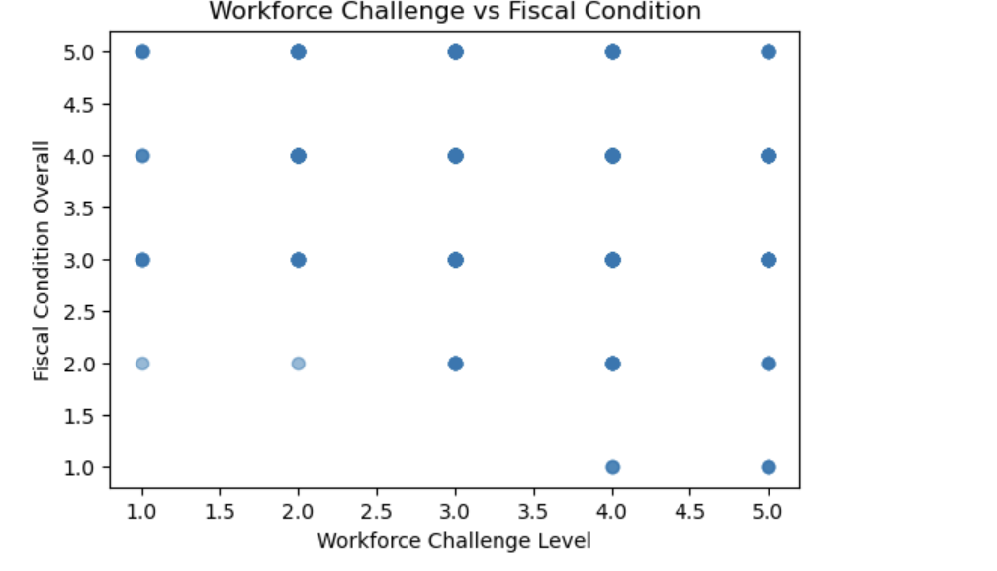
Scatter Plot Analysis
Scatter Plot of Workforce Challenge and Fiscal Condition
We used scatter plots to visually explore the relationship between workforce challenge level and fiscal condition overall. Scatter plots helped us see whether the relationship is strong, weak, positive, or negative. From the graph, the pattern appears present but not very strong, which matches the weaker correlation values seen earlier.

Slide 10
Separate Regression by Dataset
Separate Regression Models for ARISE and CivicPulse
We ran separate regression models for each dataset to see whether workforce challenge and infrastructure stress influence fiscal condition differently in ARISE and CivicPulse.
This helped us compare dataset-specific patterns instead of assuming both surveys behave in the same way. The results suggest that some relationships, especially infrastructure stress, can appear differently depending on which dataset is analyzed.

Slide 11
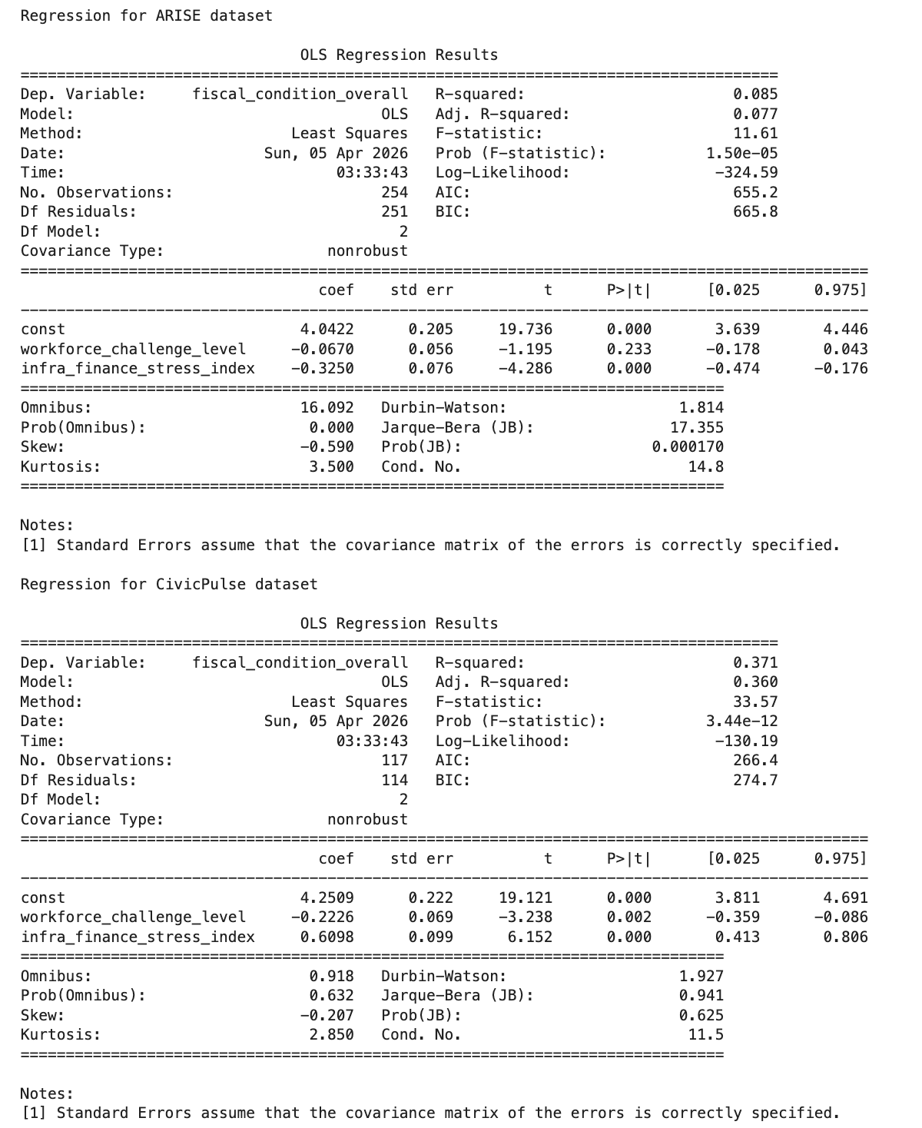
ARISE &Civic Pulse- Dataset

Slide 12
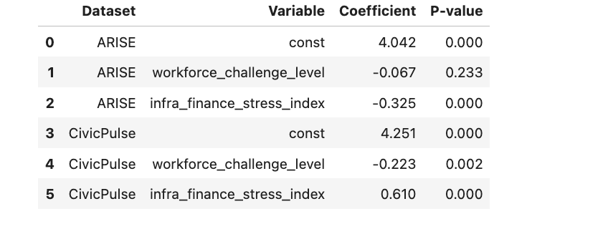
Combined Regression
Combined Regression with Source Control
We then ran a combined regression model using both datasets together while controlling for dataset source. This allowed us to test whether the relationships remain consistent after combining ARISE and CivicPulse.
The combined model gives a broader overall picture. It helped us understand which variables remain more stable across both datasets and which effects become weaker after accounting for survey source differences.

Slide 13
Main Insight from This Week
Key Takeaways from This Week
Correlation analysis gave us an overview of how the main variables are related
Cross-tabulations showed detailed category-level patterns
Percentage cross-tabs improved comparison by showing proportions
Visualizations made the patterns easier to understand
Separate regression showed dataset-specific differences
Combined regression helped identify more general relationships across both datasets
This week’s work moved the project from dataset preparation into actual analytical interpretation.

Slide 14
Next Week Goal
Next Week Goal
Next week, we plan to:
Interpret the regression results more clearly
Write final analytical findings in simple language
Connect the results back to the project research questions
Improve presentation visuals and explanations
Finalize the report and conclusions for submission

